Slide 1
Polymorphism, Virtual functions & Abstract Classes

Slide 2
Polymorphism
The word polymorphism means having multiple forms.
The term Polymorphism gets derived from the Greek word where poly + morphos where poly means many and morphos means forms.
Polymorphism in programming means: a function the same as another in name but with different behavior.
Polymorphism
Compile time
Run time
Function Overloading
Function Overriding
Virtual Functions

Slide 3
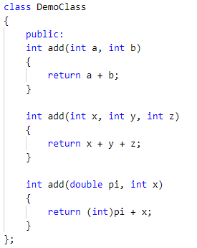
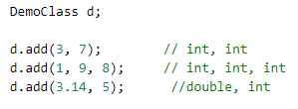
Polymorphism
Compile time Polymorphism

Slide 4
Polymorphism (contd..)
You can pass an object of a derived class to a formal parameter of the base class type

Slide 6
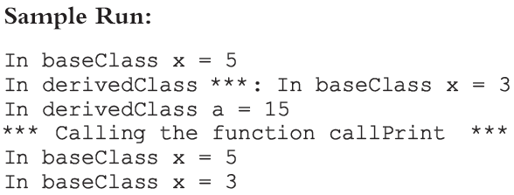
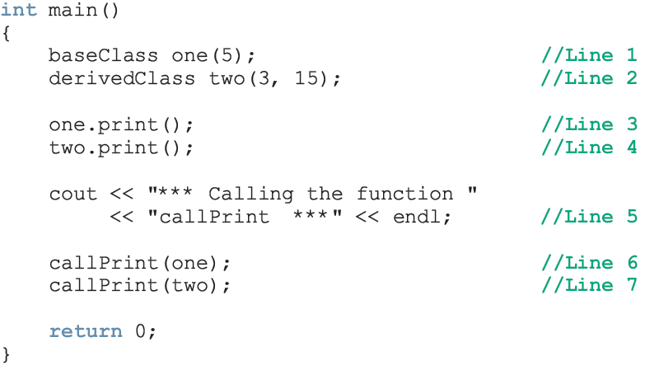

Slide 7
Polymorphism (contd..)
For both statements (Lines 6 and 7), member function print of baseClass was executed
Because the binding of print, in the body of callPrint, occurred at compile time
Compile-time binding: the necessary code to call a specific function is generated by the compiler
Also known as static binding or early binding

Slide 8
Virtual Functions
How can we avoid this problem?
Virtual functions (reserved word virtual)
Virtual function: binding occurs at program execution time, not at compile time
This kind of binding is called run-time binding
Run-time binding: compiler does not generate code to call a specific function; it generates information to enable run-time system to generate specific code for the function call
Also known as dynamic binding

Slide 9
Virtual Functions (contd…)

Slide 10
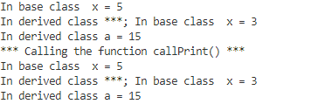
Sample Run

Slide 11
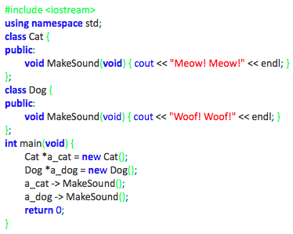
Type compatibility – the simplest case
Each new class constitutes a new type of data. Each object constructed on the basis of such a class is like a value of the new type.
This means that any two objects may (or may not) be compatible in the sense of their types.
Take a look at the very simple example on the right →

Slide 12
Type compatibility – the simplest case cont’d
The objects of the Cat class are not compatible with the objects of the Dog class, although the structure of both classes is identical. Neither of the following assignments is valid and both of them will cause a compiler error:
a_dog = a_cat;
a_cat = a_dog;
As you see, the Dog and Cat classes have nothing in common in the sense of inheritance – they’re both completely independent.
So we can say that objects derived from classes which lie in different branches of the inheritance tree are always incompatible.
The program will produce the following output:
Meow! Meow!
Woof! Woof

Slide 13
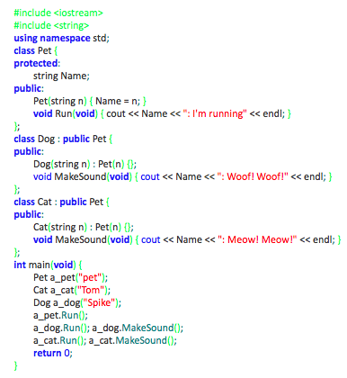
Type compatibility – more complex case (1)
We’ve rebuilt our example significantly. We still have the two previous classes Dog and Cat, but we’ve put them into the same inheritance tree. Take a look →

Slide 14
Type compatibility – more complex case (1) cont’d
objects of the superclass are compatible with objects of the subclass
objects of the subclass are not compatible with objects of the superclass
This means that:
you can do the following:
a_pet = new Dog("Huckleberry");
a_pet -> Run();

Slide 15
Type compatibility – more complex case (1) cont’d
but you cannot do anything like this:
a_pet -> MakeSound();
because Pets don’t know how to make sounds (in our world of classes, at least)
you are not allowed to do the following:
a_dog = new Pet("Strange pet");

Slide 16
Classes and Virtual Destructors
Classes with pointer member variables should have the destructor
Destructor can be designed to deallocate storage for dynamic objects
If a derived class object is passed to a formal parameter of the base class type, destructor of the base class executes
Regardless of whether object is passed by reference or by value
Solution: use a virtual destructor (base class)

Slide 17
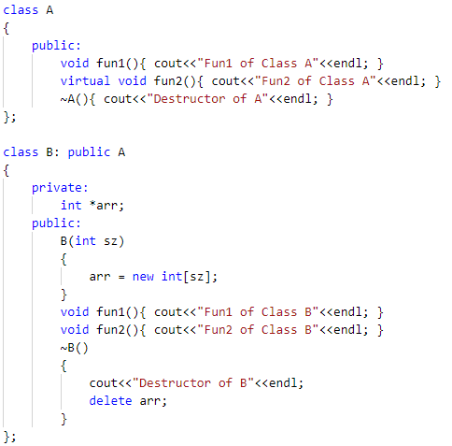
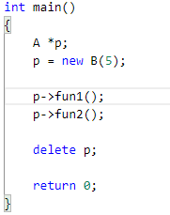

Output

Slide 18
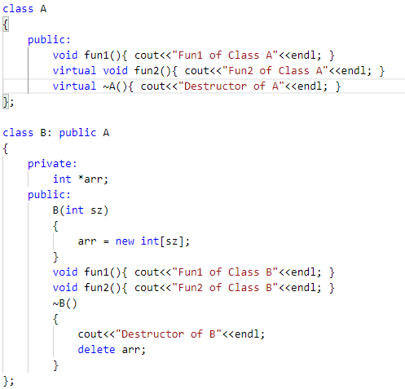

Output

Slide 19
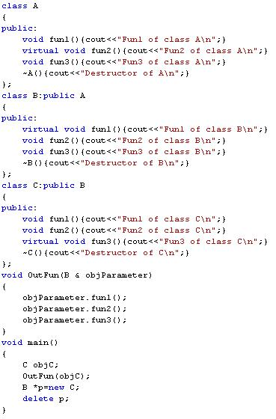
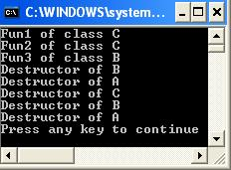
Virtual functions for class A:
fun2
Virtual functions for class B:
fun1 and fun2
Virtual functions for class C:
fun1 and fun2 and fun3

Slide 20
Classes and Virtual Destructors (continued)
The virtual destructor of a base class automatically makes the destructor of a derived class virtual
After executing the destructor of the derived class, the destructor of the base class executes
If a base class contains virtual functions, make the destructor of the base class virtual

Slide 21
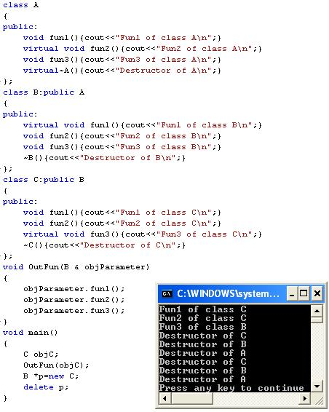

Slide 22
Working
The virtual function is bound to the function body accurately at runtime by using the concept of the virtual table (VTABLE) and a hidden pointer called _vptr.

Slide 23
VTable
The compiler at compile time sets up one VTABLE each for a class having virtual functions as well as the classes that are derived from classes having virtual functions.
A VTABLE contains entries that are function pointers to the virtual functions that can be called by the objects of the class. There is one function pointer entry for each virtual function.
In the case of pure virtual functions, this entry is NULL. (This the reason why we cannot instantiate the abstract class).

Slide 24
_vptr
Next entity, _vptr which is called the vtable pointer is a hidden pointer that the compiler adds to the base class.
This _vptr points to the vtable of the class.
All the classes derived from this base class inherit the _vptr.
Every object of a class containing the virtual functions internally stores this _vptr and is transparent to the user.
Every call to virtual function using an object is then resolved using this _vptr.

Slide 25
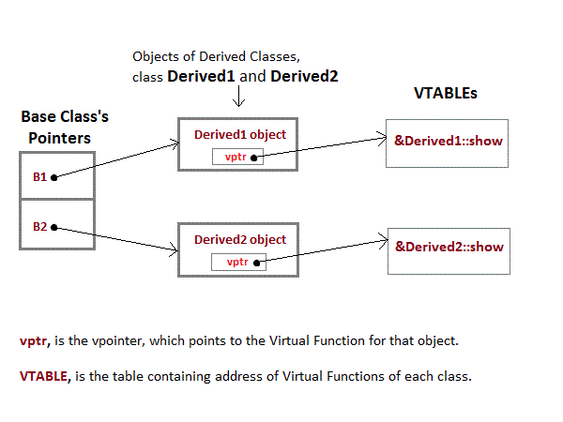

Slide 26
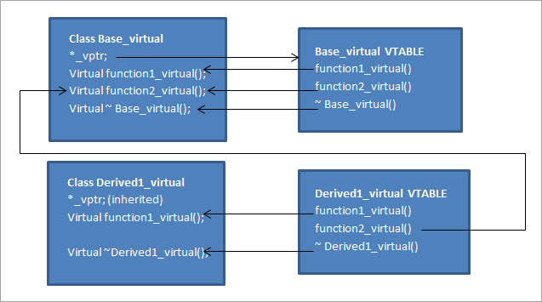

Slide 27
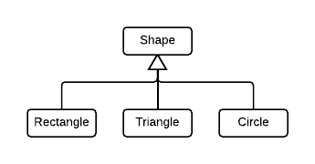
Abstract Classes and Pure Virtual Functions
Through inheritance, we can derive new classes without designing them from scratch
Derived classes inherit existing members of base class, can add their own members, and also redefine or override public and protected member functions
Base class can contain functions that you would want each derived class to implement
Base class may contain functions that may not have meaningful definitions in the base class

Slide 28
Abstract Classes and Pure Virtual Functions (continued)
To make them pure virtual functions:

Slide 29
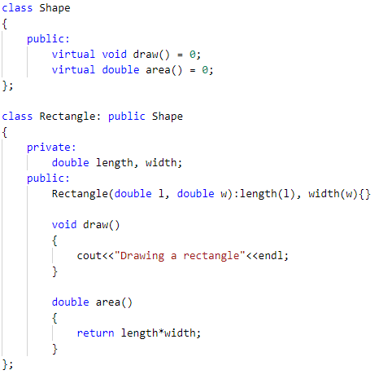
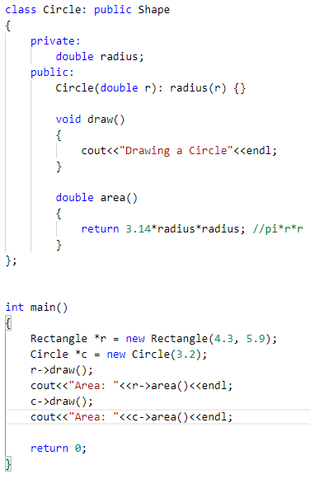

Abstract Classes – Shapes
Output

Slide 30
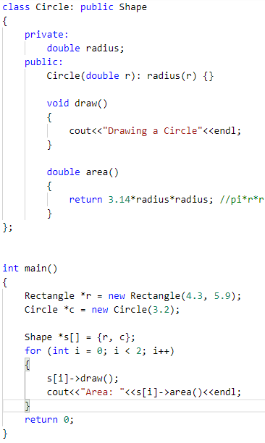

Abstract Classes – Shapes
Output

Slide 31
Abstract Classes and Pure Virtual Functions (continued)
Abstract class: contains one or more pure virtual functions
You cannot create objects of an abstract class

Slide 32
Abstract Classes and Pure Virtual Functions (continued)
If we derive rectangle from shape, and want to make it a nonabstract class:
We must provide the definitions of the pure virtual functions of its base class
Note that an abstract class can contain instance variables, constructors, and functions that are not pure virtual
The class must provide the definitions of constructor/functions that are not pure virtual

Slide 33
